Slide 1
EMERGING TRENDS IN ENGLISH LANGUAGE TEACHING
Dr.M.KANNADHASAN
Assistant Professor
Department of English
Thiruvalluvar University
Serkkadu, Vellore

Slide 2
What is Trend?
A trend is the general tendency or direction towards change.

Slide 3
Methods
Approches
Techniques

Slide 4
What is a method?
All methods include prescriptions for the teacher and the learners.
All methods are a pre-packaged set of specifications of how the teacher should teach and how the learner should learn derived from a particular theory of language and a theory of language learning.

Slide 5
What is a method?
For the teacher, methods prescribe what materials and activities should be used, how they should be used and what the role of the teacher should be.
For learners, methods prescribe what approach to learning the learner should take and what roles the learner should adopt in the classroom.

Slide 6
What is an approach?
Underlying each method is a theory on the nature of language and a theory on the nature of language learning both of which comprise the approach.
These theories are derived from the areas of linguistics, sociolinguistics, psycholinguistics and are the source of principles and practices of language teaching.

Slide 7
What is an approach influenced by?
  Theory of language: How is language viewed?
    Structural View of Language.
    Functional View of Language.
Theory of language learning: How do learners learn the language?
      What are the psychological and cognitive processes involved (habit formation, induction, inferencing, generalization)?
      What are the conditions that need to be met for these learning processes to be activated?

Slide 8
Theory of language – focus of teaching
  If language is seen as a system of structurally related elements for the coding of meaning:
    What dimension of language is prioritized?
      Grammatical dimension.
    What needs to be taught?
      Phonological units.
      Grammatical units and operations.
      Lexical items.

Slide 9
Theory of language – focus of teaching
If language is viewed as a vehicle for the expression of functional meaning:
    What dimension of language is prioritized?
      semantic and communicative dimension of language.
    What needs to be taught?
      functions, notions of language.

Slide 10
Components of a method

Slide 11
Syllabus
Syllabus is the level at which theory is put into practice and at which choices are made about the content to be taught, the skills to be developed, the order of the content etc.
The theory of language adopted will affect the organisation and selection of language content.
Different methods have different types of syllabi associated with them i.e. different ways of selecting and organising content.

Slide 12
Teaching/Learning Practices
Types of learning tasks and activities to be used in the classroom.
Roles of learners in the classroom: the degree of control that learners have over their learning, roles that learners will assume in the classroom, learning groupings recommended.
Roles of teachers: functions that the teacher is to fulfil in the classroom, the degree to which the teacher influences the learning process and the kind of interaction between the teacher and the learners.

Slide 13
Teaching/Learning Practices (2/2)
Role of materials: the function of materials in the learning process and the forms they take. In some methods, materials are designed to replace the teacher so that learning can take place independently. In others, materials are teacher proof so that even poorly trained teachers with imperfect control of the language can use them.

Slide 14
Assessment
How students’ language knowledge is to be assessed.
Error correction policy.

Slide 15
How do all of these relate?
Different theories about the nature of language and how languages are learned (the approach) imply different ways of teaching language (the method) and different methods make use of different kinds of classroom activities (the techniques).

Slide 16
Grammar Translation
Traditional way of teaching Latin and Greek. In the 19th century used to teach French, German and English.
Typical lesson consisted of a) presentation of grammatical rule, b) specially written text that demonstrated the rule, c) list of new words, d) translation exercises, e) grammar exercises.
Emphasis on learning to read and write.
Vocabulary is taught in the form of lists of isolated words.

Slide 17
Grammar Translation
Long, elaborate explanations of the intricacies of grammar are given.
Medium of instruction was the mother tongue.
No provision for the oral use of language.
Little attention is paid to the content of texts, which are treated as exercises in in grammatical analysis.
Often the only drills are exercises in translating disconnected sentences from the target language into the mother tongue.

Slide 18
Direct Method
Posited by Charles Berlitz.
Second language learning is similar to first language learning.
Emphasis on:
  oral interaction,
  spontaneous use of language,
  no translation,
  little if any analysis of grammatical rules and structures.

Slide 19
Direct Method
Classroom instruction was conducted in the target language.
There was an inductive approach to grammar.
Only everyday vocabulary was taught.
Concrete vocabulary was taught through pictures and objects.
Abstract vocabulary was taught by association of ideas.

Slide 20
Direct Method
New teaching points were introduced orally.
Communication skills were organized around question-answer exchanges between teachers and students.
Speech and listening comprehension were taught.
Correct pronunciation and grammar were emphasised.

Slide 21
The Audiolingual Method
Outbreak of the World War II:
  Heightened the need to become orally proficient.
  “The Army Method” (an oral-based approach to language learning).
Influenced by structuralism and behaviourism:
  Identify the grammatical structures and the basic sentence patterns.
  Practice these patterns by systematic attention to pronunciation and intensive oral drilling.

Slide 22
The Audiolingual Method (1950’s)
New material is presented in dialogue form.
There is dependency on mimicry, memorization of set phrases, and overlearning.
By constant repetition the learner develops habits. Language learning is seen as acquiring a set of appropriate mechanical habits; errors are not accepted because the lead to the development of bad habits.
The role of the teacher is to develop good language habits.

Slide 23
The Audiolingual Method
There is little or no grammatical explanation. Grammar is taught inductively.
Great importance is attached to pronunciation.
Very little use of the mother tongue by teachers is permitted.
Successful responses are reinforced.
There is great effort to get students to produce error-free utterances.

Slide 24
Typical audiolingual activities
Dialog memorization.
Repetition drill: Students repeat the teacher’s model as accurately and as quickly as possible to learn the lines of the dialog.
Transformation drill: The teacher gives students a certain kind of sentence pattern. Students are asked to transform a sentence into a negative sentence.
Question-and-answer drill: This drill gives students practice with answering questions.

Slide 25
Typical audiolingual activities
Complete the dialog: Selected words are erased from a dialog. Students complete the dialog by filling the blanks with the missing words.
  e.g. Lucy: I hear Mary got the first prize in that painting competition.
  Rose: …
  Lucy: Did she really?
  Rose: Yes she did. I saw her painting and it really was good.

Slide 26
Designer Methods (Humanistic Approaches) 1970’s & 1980’s
Influenced by principles of psychology and psychotherapy.
Developed in 70’s and 80’s mainly in US.
The Silent way.
Total physical response.
Suggestopedia.
Community language learning.

Slide 27
The silent way (Caleb Gattegno)
Characterized by a problem-solving approach.
Develops independence and autonomy and encourages students to cooperate with each other.
  Learning is facilitated if the learner discovers or creates rather than remembers and repeats what is to be learned.
  Learning is facilitated by accompanying (mediating) physical objects).
  Learning is facilitated by problem solving the material to be learned.

Slide 28
The silent way (Caleb Gattegno)
[1
Sound-colour chart: Each colour symbolizes one sound.

Slide 29
Typical techniques (1/3)
Sound-Colour Chart: The teacher refers students to a color-coded wall chart depicting individual sounds in the target language - students use this to point out and build words with correct pronunciation.
Teacher's Silence: Teacher is generally silent, only giving help when it is absolutely necessary.
Peer Correction: Students encouraged to help each other in a cooperative and not competitive spirit.

Slide 30
Typical techniques
Self-correction Gestures: Teacher uses hands to indicate that something is incorrect or needs changing - e.g.. using fingers as words then touching the finger/word that is in need of correction.
Word Chart: Words are depicted on charts, the sounds in each word corresponding in colour to the Sound-Colour Chart described above - students use this to build sentences.

Slide 31
Typical techniques
Fidel Chart: A chart that is color-coded according to the sound-colour chart but includes the various English spellings so that they can be directly related to actual sounds.

Slide 32
Suggestopedia
One of the innovative methods dating back to the 1970’s (Georgi Lozanov). Lozanov suggests that the human brain could process great quantities of material if simply given the right conditions for learning, among which are a state of relaxation and giving over the control of the teacher. Music is central to this method. Lozanov (1982) indicates that this method transcends the language classroom and can be applied in other school subjects. He claims that about 200 to 240 new words may be introduced each lesson.

Slide 33
Suggestopedia
Learning is facilitated in an environment that is as comfortable as possible, featuring soft cushioned seating and dim lighting.
"Peripheral" learning is encouraged through the presence in the learning environment of posters and decorations featuring the target language and various grammatical information.
The teacher assumes a role of complete authority and control in the classroom.

Slide 34
Suggestopedia
Self-perceived and psychological barriers to learners' potential to learn are "desuggested".
Students are encouraged to be child-like, take "mental trips with the teacher" and assume new roles and names in the target language in order to become more "suggestible".
Baroque music is played softly in the background to increase mental relaxation and potential to take in and retain new material during the lesson.

Slide 35
Suggestopedia
Students work from lengthy dialogs in the target language, with an accompanying translation into the students' native language.
Errors are tolerated, the emphasis being on content and not structure. Grammar and vocabulary are presented and given treatment from the teacher, but not dwelt on.

Slide 36
Suggestopedia
Homework is limited to students re-reading the dialog they are studying - once before they go to sleep at night and once in the morning before they get up.
Music, drama and "the Arts" are integrated into the learning process as often as possible.

Slide 37
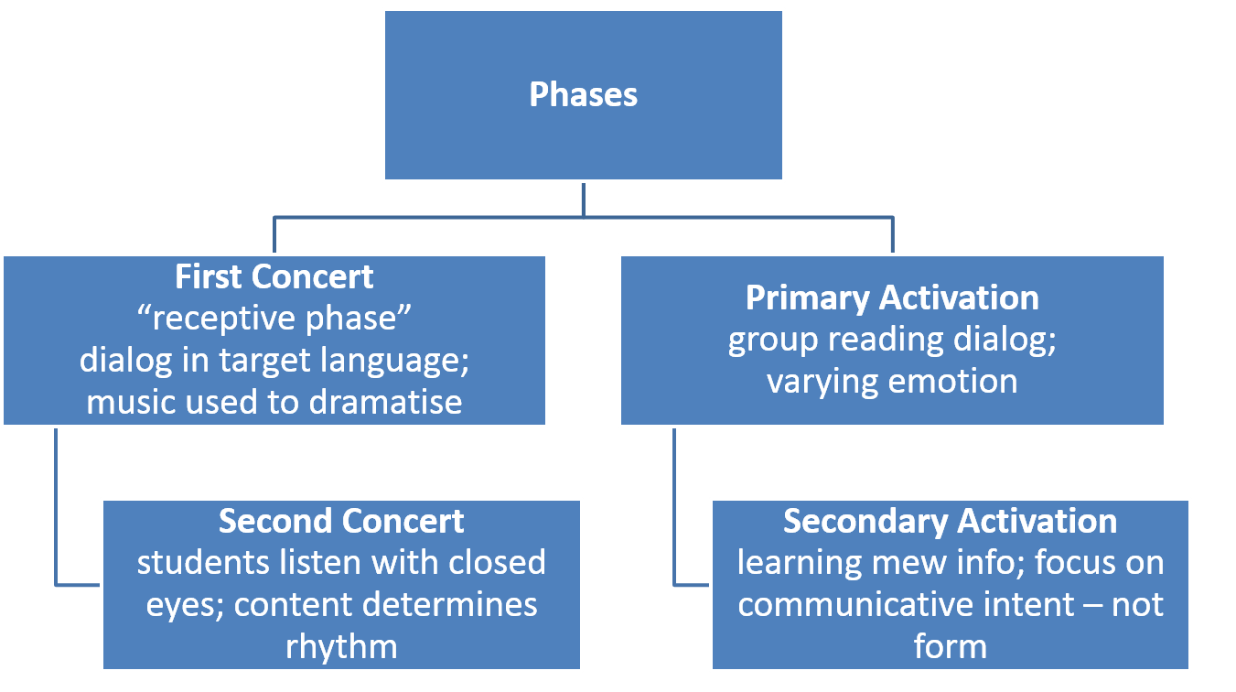
Suggestopedia

Slide 38
Total Physical Response
TPR is an approach to teaching a second language, based on listening linked to physical activities which are designed to reinforce comprehension.
TPR is a method developed by Dr. James J. Asher to aid learning second languages.
The method relies on the assumption that when learning a second or additional language, that language is internalized through a process of code-breaking similar to first language development.
Students respond to commands that require physical movement.

Slide 39
Total Physical Response
Successful second language learning should be a parallel process to child first language acquisition.
Appropriate activities can produce stress-free learning.
Learners are encourage to speak when they feel ready to speak.
Theory of language:
  a grammar based view of language.
  verb in ımperative form.
Theory of language learning:
  a stimulus-response view.

Slide 40
Communicative language teaching (1980s)
  An emphasis on learning to communicate through interaction in the target language. Authentic and meaningful communication should be the goal of classroom activities.
The introduction of authentic texts into the learning situation.
The provision of opportunities for learners to focus, not only on the language but also on the learning process itself.

Slide 41
Communicative language teaching (1980s)
An enhancement of the learner's own personal experiences as important contributing elements to classroom learning.
An attempt to link classroom language learning with language activation outside the classroom.
Fluency is an important dimension of communication.
Communication involves the integration of different language skills.
Learning is a process of creative construction and involves trial and error.

Slide 42
Task-based language learning
Task-based language learning (TBLL) is a method of instruction which focuses on the use of authentic language, and students doing meaningful tasks using the target language; for example, visiting the doctor, conducting an interview, or calling customer services for help.
Assessment is primarily based on task outcome (ie: the appropriate completion of tasks) rather than simply accuracy of language forms. This makes TBLL especially popular for developing target language fluency and student confidence.

Slide 43
Task-based language learning
In TBLL the role of the teacher changes from that of an instructor and prosecutor of errors to that of a supporter and inventor of tasks which her/his learners enjoy doing.
It proved useful to divide the learning process in TBLL in three phases: The pre-task phase, the doing of the task, and the post-task phase. Taken together they form a task cycle. The major role of the teacher changes from phase to phase.

Slide 44
Problems associated with methods
No general agreement on what method is: Any principled choice of techniques can be termed “method”.
Some methods not based on clear language and language learning theory.
Methods are open to wide interpretation by materials developers and teachers.

Slide 45
Problems associated with methods
Methods that present themselves as “state of the art” have in essence been around for thousands of years. Total corpus of ideas available to language teachers has not basically changed in 2000 years. In essence methods represent different configurations of the same basic options.

Slide 46
Problems associated with methods
The rise and fall of methods is mainly due to the influence of profit seekers, promoters and forces of the intellectual marketplace. Methods become influential when they gain the seal of approval by university departments.
Language teaching is a massive industry where much is done in the name of profit and glory.

Slide 47
Problems associated with methods
Most methods have been developed in western developed countries (US and UK). Fallacy that anything imported by US and UK is by nature effective and advanced.
Methods developed in a specific educational, social and cultural context cannot be exported wholesale and used in countries with different philosophies, values and beliefs.

Slide 48
Eclectic Approach in Teaching English
Larsen-Freeman (2000) and Mellow (2000) both have used the term principled eclecticism to describe a desirable, coherent, pluralistic approach to language teaching.
Eclecticism involves the use of a variety of language learning activities, each of which may have very different characteristics and may be motivated by different underlying assumptions.

Slide 49
Eclectic Approach in Teaching English
The use eclecticism is due to the fact that there are strengths as well as weaknesses of single theory based methods. Reliance upon a single theory of teaching has been criticized because the use of a limited number of techniques can become mechanic.
The teacher decides what methodology or approach to use depending on the aims of the lesson and the learners in the group. Almost all modern course books have a mixture of approaches and methodologies.

Slide 50
Advantages of an eclectic approach
Safety: The use of a variety of ideas and procedures from different existing approaches and methods will increase the chances of learning taking place.
Interest: Teachers need to use different techniques to hold the learners' attention.
Diversity: Different learning/teaching contexts require different methodologies.
Flexibility: Awareness of a range of available techniques will help teachers exploit materials better and manage unexpected situations. Informed teaching is bound to be eclectic.

Slide 51
References
Larsen-Freeman, D. (2000). Techniques and Principles in Language Teaching. Oxford University Press.
Mellow, J. D. (2000). Western influences on indigenous language teaching. In J. Reyhner, J. Martin, L. Lockard, & W. Sakiestewa Gilbert (Eds.), Learn in beauty: Indigenous education for a new century (pp. 102-113). Flagstaff, AZ: Northern Arizona University.

